Slide 1

Presenter:-Chaitany Soni
Chaitanysoni007@gmail.com

Slide 2

Etiquette in simpler words is defined as good behaviour which distinguishes human beings from animals.
Etiquette means behaving yourself a little better than a absolutely essential.
Etiquette refers to guidelines which control the way a responsible individual should behave in the society.

Slide 3
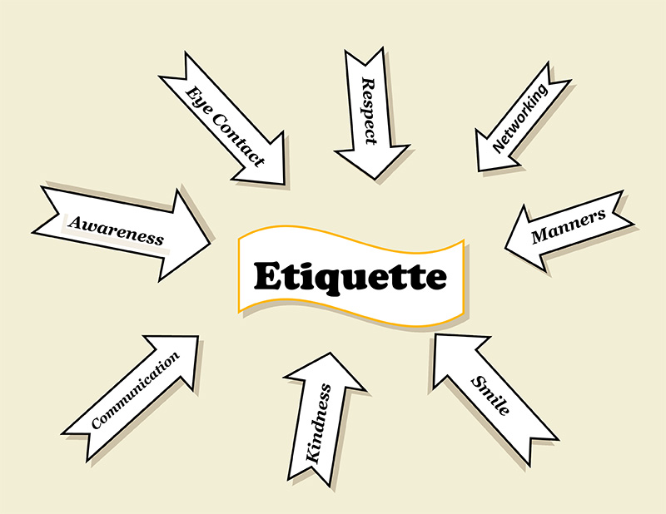

Slide 4

Etiquette makes you a cultured individual who leaves his mark wherever he goes.
Etiquette teaches you the way to talk, walk and most importantly behave in the society.
Etiquette is essential for an everlasting first impression. The way you interact with your superiors, parents, fellow workers, friends speak a lot about your personality and up- bringing.
Etiquette enables the individuals to earn respect and appreciation in the society. No one would feel like talking to a person who does not know how to speak or behave in the society.Etiquette helps individuals to value relationships.

Slide 5

Eating Etiquettes
Telephone Etiquettes
Corporate Etiquettes
Meeting Etiquettes
Business Etiquettes
Social Etiquettes

Slide 6
Eating Etiquette- Individuals must follow certain decorum while eating in public.
Wash your hand before and after the meal
Don’t make noise while eating. One should not leave the table unless and until everyone has finished eating.
Chew with your mouth closed
Hold your utensils properly
Wait to be served

Slide 7
Ask for whatever you want instead of reaching out directly or pointing at dishes
Don’t talk with food in your mouth
Don’t talk on your cell phone during the meal and if you want to get up in between,ask to be “excused”
Don’t put your elbows on the table

Slide 8
Telephone Etiquette- It is essential to learn how one should interact with the other person over the phone.
Telephone etiquette refers to the way an individual should speak on the phone.
Ensure the number is correct
Identify yourself imediately,don’t make them guess who is calling
Never put the other person on long holds. Make sure you greet the other person.

Slide 9
Take care of your pitch and tone
Know how to answer the phone
Don’t spend hours talking
Don’t interrupt while the other person is speaking.
Observe courtesies like “Hello”,”Please”,”Thank you” and “good bye”
Ask them if it’s convenient to talk now.make sure you are not disturbing them
If you dial up wrong number,apologise don’t just hang up

Slide 10
Corporate Etiquette- Corporate Etiquette refers to how an individual should behave while he is at work.
Each one needs to maintain the decorum of the organization.
Treat your co-workers,cleaners,maintenance people and other with respect and courtesy
Show respect for each others workspace,knock before entering
Don’t gossip about any co-workers private life
Reach office on time

Slide 11
Take responsibility for your mistakes,apologise and go about correcting the mistakes
Keep your work area tidy,try not to be messy
Always give respect to older than yourself even if they are junior to you in position
Put your phone on silent or vibrating mode at workplace
Make sure you turn off the monitor while you go out for lunch or tea breaks
Never wear casual wears at work.and females should avoid wearing heavy jewellery at work

Slide 12
Meeting Etiquette- Meeting Etiquette refers to styles one need to adopt when he is attending any meeting, seminar, presentation and so on.
Listen to what the other person has to say.
Never enter meeting room without a notepad and pen. It is important to note down important points for future reference
Pay attention to the proceedings quietly,don’t shuffle your papers

Slide 13
Do not dominate the meeting.All communication must take place through the chairperson
Never be late for Meeting,it is extremely rude to arrive late for meeting
Meeting should have a break every two houurs.breaks should be 20 minutes long and meal break should be 30 minutes long
Do not leave the meeting until it is closed by the chairperson
As the meeting leader,Thank people for attending and request feedback
As the participant,provide your feedback

Slide 14
Business Etiquette- Business Etiquette includes ways to conduct a certain business.
Don’t ever cheat customers. It is simply unethical.
Your customers rely on your expertise and knowledge.So,be helpful and honest
If there is conflict,do not get personal in your remarks
Keep calm.do not loose your temper
The old adage that the customer is always right

Slide 15
If you have a website it should be a pleasure not a pain to visit
Keep your website informative and helpful
Speak softly,clearly with good eye contact to your customers
If you employ a receptionist,make sure that they do not take out their frustration on your clients

Slide 16
Social Etiquette- Social etiquette is important for an individual as it teaches how to behave in the society
Say Thank you always,Specially when someone holds or open the door for you
Walk on the sides of the road
Don’t talk while you cross a road or driving a vehicle
Wear headphones when you listening a music in public
Do not smoke in prohibited places
Leave the seats for ladies and disabled persons in bus or train,if possible
To conclude, etiquette transforms a man into a gentleman.

Slide 17
Take permission to enter in someone’s personal room
Be on time
Talk quietly
Don’t split in public place
Do not cough or sneeze in anyone’s direction.use a tissue,if possible
Don’t talk behind others back
Don’t swear-It impresses nobody

Slide 18

Eating Etiquette

Slide 19
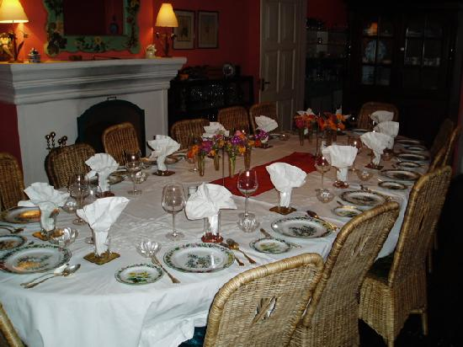
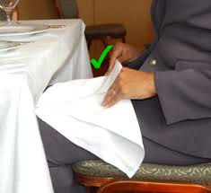
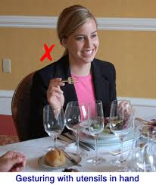
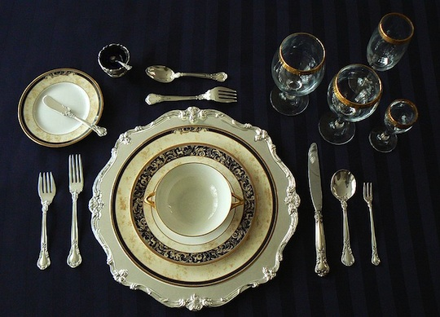

Slide 20
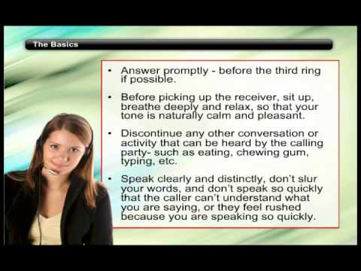
Telephone Etiquette

Slide 21

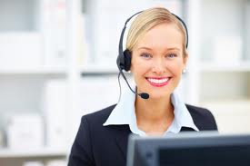
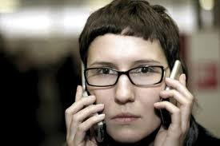

Slide 22

Corporate Etiquette

Slide 23

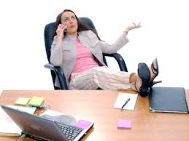

Slide 24

Meeting Etiquette

Slide 25
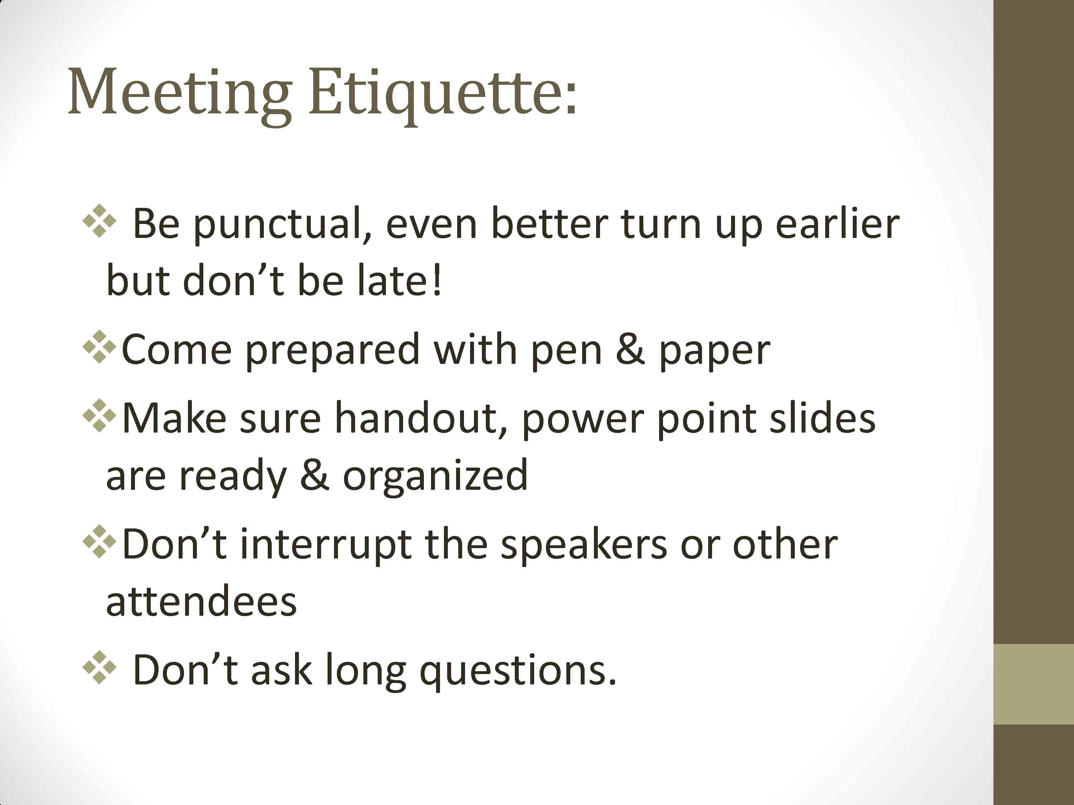

Slide 26
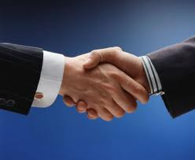
Business Etiquette

Slide 27
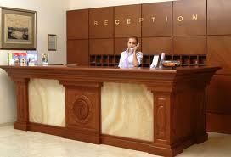


Slide 28

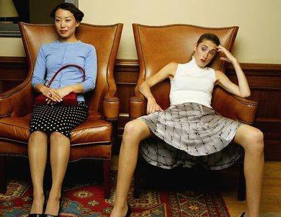


Social Etiquette

Slide 29

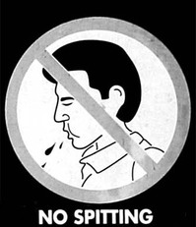
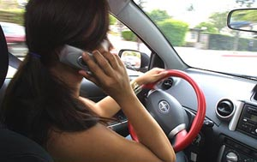
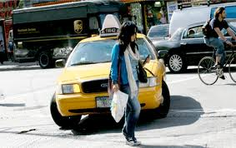

Slide 30
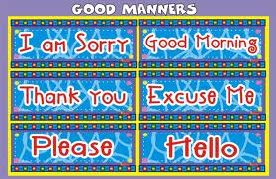
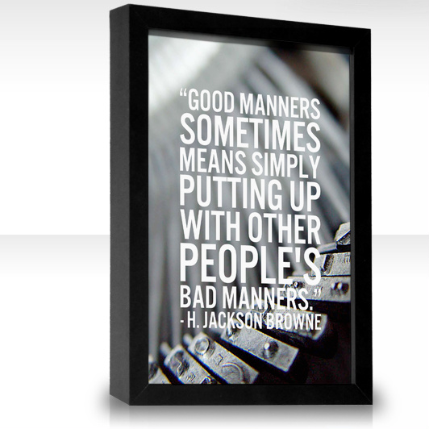
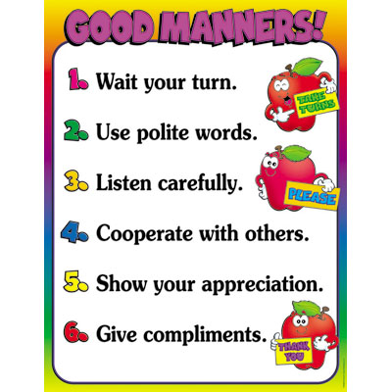
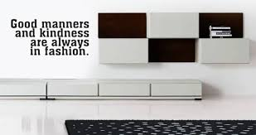
General
manners

Slide 31

In the business arena:
  Only men should stand for handshaking and all introductions
  Only women should stand for handshaking and all introductions
  It is not necessary for men or women to stand for handshaking and all introductions
  d) Both men and women should stand for handshaking and all introductions

Slide 32

For easy reading, one’s name badge should be worn:
  On the left shoulder
  On the right shoulder
  On the left hip
  d) Around one’s neck

Slide 33

The best way to meet people at a business or social function is to:
  Head for the bar or buffet immediately upon arrival
  Introduce yourself to two people who are standing close and talking softly
  Look confident, standing in the center of the room, and wait for someone to approach you
  d) Introduce yourself to a person standing alone

Slide 34

When you are dining with someone important and your cell phone rings, you:
  Answer it within two rings and keep the call brief
  b) Ignore it and pretend that someone else’s phone is ringing
  c) Apologize and turn the phone on silent mode. The person you’re with takes priority.
  d) Apologize, step away from the table, and take the call in the lobby or restroom.

Slide 35

If you have a morsel of food lodged in your teeth and you want to remove it, you:
  Take your knife when no one is looking and remove the morsel promptly with the blade
  Raise your napkin to your mouth and discreetly use a sugar packet or your business card to remove the morsel
  c) Politely ask your server for a toothpick
  d) Excuse yourself and go to the restroom to pick your teeth in private

Slide 36

When two business people communicate, how far apart should they stand?
  1.5 feet
  3 feet
  7 feet

Slide 37

When answering a business phone, always answer
  With a simple hello. It sounds more approachable and less pretentious.
  With your name
  With your name, department, title, and a greeting

Slide 38

You have just heard a coworker in the cubicle next to
yours speak rudely to a client on the phone. You should:
a) Wait until the call is finished, then tell the person
that their behavior is unacceptable
  b) Tell your boss
  c) Respect your coworker’s privacy and refrain from commenting

Slide 39

When you reach a doorway at the same time as another person, the following rules apply:
  Whoever arrives first should open it and hold it for those who are following
  Men should always open doors for women
  Women should open doors for men to prove that they are no longer oppressed
  d) Always open the door for someone of either Gender if that person has his or her hands full

Slide 40
Question 10
When making a business introduction, You should:
  A) Wing it
  b) Introduce the less important/junior person to the more important/senior person
  c) Introduce the more important/senior person to the less important/senior person
  d) Don’t do anything. It is their responsibility to introduce themselves

Slide 41
Some Very Nice Quotes on Manners
“Friends and good manners will carry you where money won’t go.”
“To succeed in the world it is not enough to be stupid,
you must also be well-mannered.”
“Politeness is the flower of humanity”
“It's nice to be important, but it's more important to be nice.”

Slide 42
“Sometimes Good manners will open doors that the best education cannot.”
“You can get through life with bad manners, but it's easier with good manners.”
“The test of good manners is to be patient with the bad ones.”
“Doesn't matter what a person's name is as long as he behaves himself.”

Slide 43
Thank You

